Slide 1
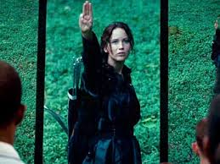

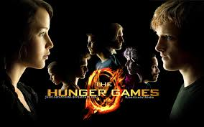
Post-Apocalyptic Worlds: Surviving Together and Apart

Slide 2
Lesson Aims and Objectives:
To explore Post-apocalyptic and dystopian texts
Investigate the theme The Hunger Text raises and the relevance to contemporary society
Develop ways of taking the texts into the classroom to stimulate analysis of texts.

Slide 3
Introduction:
moving beyond the disaster films
trend in Young Adult fiction
why?
- escapism
- moving away from issue-based fiction
What are the general themes of post apocalypse fiction?

Slide 4
Definitions:
Dystopian fiction: a work of fiction describing an imaginary place where life is extremely bad because of deprivation or oppression or terror
Post-Apocalyptic fiction: a work of fiction set in a world or civilization after a potentially existential catastrophe or disaster

Slide 5
THE FUTURE
How do you see the future? If you were someone living in the salad days of the ‘50s and ‘60s, there were promises of interstellar exploration, flying cars, high tech lifestyles, and meaningful medical breakthroughs. We’d cure all diseases, live like royalty within our own slick scientific reality, and never once worry about modern maladies like hunger, war, or death. This is Utopia, the perfect portrait of a supposed shape of things to come. Yet for every optimist there’s an opposite, a pessimistic perspective that’s part luddite, part ludicrous. It’s not a fear of technology that inspires these people, but where said advances will take us. Eventually, they believe our “U” will turns into a Dystopia, a horrible place where the End Times dictate our destiny.
So within this Judgment Day dynamic, this proposed post-apocalyptic wasteland of warning signs and threats, what would be the worst? Put another way, what would be the best way for a situation set on making humans the last act of a universal staging to work? If texts have taught us anything, it’s that there are lots of likely scenarios, from angry plant life to thought police persecuting the masses. In all cases, like the one presented in the recently released Warm Bodies (now on DVD and Blu-ray) the once bright future has turned shockingly sour, bringing about a dispirit finalé to our time on the planet.

Slide 6
FUTURE SOCIETIES
Questions:
What type of society will have emerged for us by 2050? What challenges will have been generated for our society at that time as a result of scientific and technological change?
What are the common themes which emerge in science fiction?
What changes in society, how will humanity’s values adapt?
Students have 5 minutes to discuss these and jot down points with a partner.
Brain storm of the board what facets of society there are in the future and build a profile of society – lead on to those written below:

Slide 7
FUTURE SOCIETIES
Government (politics)
Religion
Class Structure
Elitists (high achievers)
Technology
Science (Medicine, nature, physics, etc)
Sub-Cultures (drug, bikies, emos etc)
Exploration 9 Space)
Environmental concerns
Business
Investment market
Education
Fast and food industry
Food industry

Slide 8
PERSPECTIVES OF FUTURE SOCIETIES
Transport
Memory implants
Medical
Genetic enhancements
Classes
Education
Entertainment
Reproduction
Segregation
Hierarchy
Government
Communication
Law and order
Religion
Urban developments
Cloning
Food
Monetary system
Technology
Consumerism
Power
Wealth those who have and those who have not
Dystopian/utopian worlds
Family

Slide 9
FUTURE SOCIETIES
Consider the element of our context of society today, what may these look like in 50 years?
Let’s look at the food industry.
How does this reading of the extract impact on your understanding of our social profile.
In pairs students lists as many sci-fi texts they are aware of in both print and non print.
In groups, list as many themes that they can recognise as the subject matter of sci-fi, eg: Frankenstein: ratification creation of a human being.
As a class write a definition of science fiction.
Do we actively seek a Utopian society? How?

Slide 10
GENRES OF POST APOCALYPTIC FICTION
Warning (ignored)
Cataclysm
Barbarism
Courage
Civility
Re-evaluation
Transformation
Recovery
Demise
Apocalyptic fiction is a sub-genre of science fiction that is concerned with the end of human civilization. This apocalypse is typically portrayed as being due to a potentially existential catastrophe such as nuclear warfare, pandemic, extraterrestrial attack, impact event, cybernetic revolt, technological singularity, dysgenics, supernatural phenomena, divine judgement, runaway climate change, resource depletion, ecological collapse, or some other general disasters. Post-apocalyptic fiction is set in a world or civilization after such a disaster. The time frame may be immediately after the catastrophe, focusing on the travails or psychology of survivors, or considerably later, often including the theme that the existence of pre-catastrophe civilization has been forgotten (or mythologized). Post-apocalyptic stories often take place in a non-technological future world, or a world where only scattered elements of technology remain.
The genre gained popularity after World War II, when the possibility of global annihilation by nuclear weapons entered the public consciousness. However, recognizable apocalyptic novels had existed since the first quarter of the 19th century, when Mary Shelley's The Last Man was published.[1]

Slide 11
Christian Eschatological Imagery
Christian eschatology is a major branch of study within Christian theology. Eschatology, from two Greek words meaning last (ἔσχατος, last) and study (λογία, lit. discourse), is the study of the end of things, whether the end of an individual life, the end of the age, or the end of the world. Broadly speaking, Christian eschatology is the study of the destiny of humankind as it is revealed by the Bible, which is the primary source for all Christian eschatology studies.
The major issues and events in Christian eschatology are death and the afterlife, Heaven and Hell, the Second Coming of Jesus, the Resurrection of the Dead, the Rapture, the Tribulation, Millennialism, the end of the world, the Last Judgment, and the New Heaven and New Earth of the world to come. Eschatological passages are found in many places in the Bible, both in the Old and the New Testaments. There are also many extrabiblical examples of eschatological prophecy, as well as church traditions.

Slide 12
THE HUNGER GAMES
The Hunger Games is a 2008 science fiction novel by the American writer Suzanne Collins.
It is written in the voice of 16-year-old Katniss Everdeen, who lives in the dystopian, post-apocalyptic nation of Panem in North America.

Slide 13
THE HUNGER GAMES
PREDICTION
Show your understanding of before reading the novel and after reading the novel. Did your opinions change, why or why not:
At the heart of most people exists hope and love.
I would do anything to protect the ones I love.
If the world as we know it was destroyed and I was still alive, I would do my best to survive.
Apocalyptic writing focuses on the end of days.

Slide 14
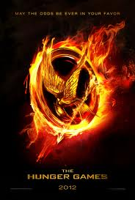
At a glance
A story written in the first person through the eyes of a sixteen-year-old year old girl named Katniss Everdeen.
Set in a post apocalyptic world in the country of ‘Panem’.
Controlled by The Capitol, a highly advanced metropolis which holds absolute power.
The Hunger Games are an annual event in which one boy and one girl aged between 12 and 18 years old are randomly selected to compete in a televised battle in which only one competitor can survive.

Slide 15
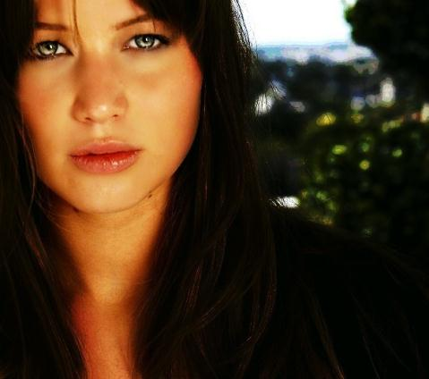
Katniss Everdeen
Katniss Everdeen is the 16-year-old protagonist. She lives in a region of District 12 known as the Seam, which is the poorest area of the district. She is described as having dark hair, olive skin, and grey eyes. She is best friends with Gale Hawthorne. She makes a living by illegally hunting with Gale in the forest borders of her district and selling her catch in the Hob, District 12's market. She volunteers to be a tribute in the Games in order to save her sister, Primrose Everdeen, who was originally chosen. She survives the Games along with Peeta Mellark and was under the mentorship of Haymitch Abernathy.

Slide 16

Peeta Mellark
Peeta Mellark is 16 years old as well, and was born in the richer part of the district to a baker. He has wavy blonde hair and blue eyes, a physical indicator of the wealthier people who were born in town, and is described as being very strong. He is the chosen male tribute to represent District 12. He saves Katniss' life multiple times during the Games, and has had a crush on her since he first saw her but never had the courage to reveal it until the Games.

Slide 17
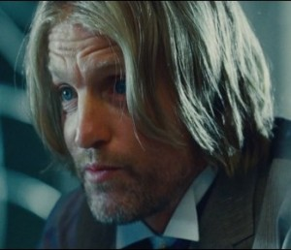
Haymitch Abernathy
Haymitch Abernathy is the mentor of Peeta Mellark and Katniss Everdeen, and is the tribute winner of the 50th Hunger Games. Haunted by the nightmares of the Games he was in, he is rarely sober throughout the book. At first he does not bother to protect Peeta and Katniss from the doom awaiting them in the Games, but after they prove their strength he guides them to the very end of the Games.

Slide 18
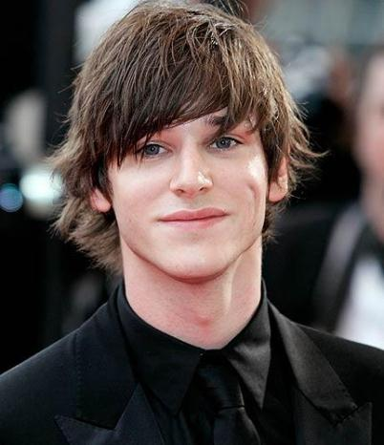
Gale Hawthorne
Gale Hawthorne is 18 in the first book of the trilogy, and is Katniss' best friend. They met in the forest a few years prior to the beginning of the novel and since then became best friends and hunting partners. Gale's appearance is similar to Katniss', as is true of most people who live in their area. Gale became head of the Hawthorne family after his father was killed along with Katniss' father in a mine explosion.

Slide 19
Setting
The Hunger Games takes place in a fictional country called Panem, which is located in what was once North America. The Capitol, the chief city and seat of government, is located somewhere in the Rocky Mountains. Disctrict 12, the home of the protagonist, is located in the coal rich Appalachian region. There are a total of 12 districts, but there once was a 13th which was destroyed in a rebellion against the Capitol. The Hunger Games take place annually in an arena specifically built for the event in an unidentified location. Panem
Panem is the name of the country where Katniss lives with her family, a country that – after a series of vague disasters – rose from the ashes of North America. Droughts, storms, fires, war: it's all pretty post-apocalyptic. We learn the history of Panem, and the Hunger Games, and the thirteen districts in the first chapter from the mayor. The uprising of the Districts is known as the "Dark Days" (1.74). After the destruction of District 13, the Treaty of Treason was signed to end the conflict, and the Hunger Games were instituted to remind the districts that the uprising must never be repeated.

Slide 20
Setting cont…
Suzanne Collins has said that Panem is supposed to be like ancient Rome: "Panem itself comes from the Latin expression 'Panem et Circenses' which translates into 'Bread and Circuses’ this term refers to the techniques used by the Roman Empire to keep the masses happy and docile by keeping their bellies full and their minds entertained.
District 12 is a very poor coal-mining district located in the region formerly known as Appalachia (3.50). Katniss and her family live in the poor section of District 12, the Seam, where the coal-miners live and work. There is also the Hob, the black market. The district is surrounded by a sometimes-electrified fence from woodlands.
The Capitol. Speaking of which, the Capitol is a shining city of wealth and grandeur city located where the Rockies used to be (3.50). The people of the Capitol are shallow, speak in a funny, affected accent and value surface appearances, plastic surgery, and entertainment. Being one of the richer districts, they also view the Games as television entertainment. Katniss, of course, despises the place.

Slide 21
Themes
Who has the power?
Well, the main source of power in The Hunger Games is clear: the totalitarian government of the Capitol. Because the Capitol holds most of the country of Panem’s wealth, the government there is able to control the people in all of the districts across Panem. The Hunger Games, then, are the ultimate display of the government’s power and were designed to warn the populace against rebellion. In the Hunger Games, the citizens of Panem become nothing more than pawns in an elaborate game of life or death. Since only one teenage contestant, or "tribute," can win, the tributes are forced to kill teens from the other districts and one from their own district. It's all symbolic of how the Capitol prevents the people in the districts from joining forces and rebelling – the Games keep the people of the districts divided and fighting among themselves. Worst of all, the government broadcasts the event live on television, reinforcing the idea that the tributes are giving their lives for little more than the entertainment of the Capitol.
Let’s not forget, though, that this book is also about ways to resist the kind of power that the Capitol represents. While the people of Panem might not have the Capitol’s money, they do have other ways of fighting back. Remember when District 12 gives Katniss their salute? Or when Katniss covers Rue’s dead body in flowers? These symbolic gestures call attention to the fact that there are actual people in the Hunger Games – real live humans, not just game pieces. In that sense, these small moments of defiance can be very powerful.
Can you find other instances of people resisting the government’s authority in the novel?
What, exactly, makes the Capitol so powerful?
Why does Katniss cover Rue’s body with flowers?
Why is the romance between Katniss and Peeta so popular with audiences?
Why won’t the Gamemakers let Katniss and Peeta eat the berries?
Why does Katniss say that the post-games interview is the most dangerous part of the Games?

Slide 22
Themes cont…
Versions of Reality
Ah, reality television: The Bachelor, The Biggest Loser, Jersey Shore. Don’t we just love it? The people of Panem, the fictional country of The Hunger Games, also watch lots of reality television, except there’s only one show they watch. It’s called the Hunger Games. Instead of contestants losing a bunch of weight or marrying a total stranger, the show is about a group of teenagers who (wait for it) kill each other in a fight to the death.
Yup, you heard us. Death.
The Hunger Games, then, asks us to think about all of the different versions of reality at play in the novel – and their consequences. What’s real and what’s not real in the Hunger Games? These are the questions we’ll be grappling with, along with the characters in the novel, throughout the series. (Be sure to head over to "Symbolism, Imagery, Allegory" for more on reality TV.)
Do you watch any reality TV shows? Did The Hunger Games change the way you view American reality TV? Why or why not?
People in the Capitol enjoy the Games as entertaining television. Why?
Why is the fake romance between Peeta and Katniss so popular with the Hunger Games’ audiences?
Why is it so important that Katniss hide her emotions on camera?
Why don’t the Hunger Games end – even after Katniss and Peeta have been declared victors?
Which character puts on the biggest show for the camera? Can you always tell when characters are being themselves versus trying to get sponsors?

Slide 23
Themes cont…
Identity
Before the Hunger Games, Katniss Everdeen was a hunter and gatherer in District 12 in the country of Panem. She didn’t much like cats, though she loved her sister very much. Her main goal was always the survival of her family. After being put in front of the Hunger Games’ cameras, though, things get kind of complicated. Katniss must craft a persona that will sell herself to the audiences at home – and to potential sponsors. Thrown into a world where image is everything, she has to play a whole new (boy crazy) Katniss on camera. But will this brand new Katniss last? Is this really her? What identity awaits her when she returns to District 12?
How would you describe Katniss in three words before the Hunger Games? After the Games?
Why is Katniss called the “girl on fire”?
Why is Peeta so concerned with staying true to himself during the Games?
How have the Hunger Games changed Katniss by the end of the novel?
If you were picked as a tribute for the Hunger Games, would you try to create a new persona for the camera? What would your strategy be for getting sponsors?

Slide 24
Themes cont…
Society and Class
The Hunger Games is a novel about the "haves" and the "have nots" – that is, the people who have money and the people who don't. The Capitol has money. Gobs of it. While the Capitol is wealthier than all of the districts, some districts are more privileged than others, so they can train their tributes to do well in the Hunger Games – a competition they see as a way to gain glory and fame. The poor districts? Well, not much of an advantage there. District 12, Katniss's district, is an impoverished coal mining region that never stands a chance in the Games. They view the Games as a punishment that must be endured – something that robs them of their children. The novel asks you, then, to think about how money can change things for you – and change how you see the world.
List some of the differences between the Capitol and District 12.
Katniss and Peeta come from different social classes within District 12. Do their social statuses influence the way that they view or approach the Hunger Games? How?
What is Katniss's favorite dish to eat in the Capitol? Why?
Why do the Career Tributes have such an advantage over everyone else?
How does wealth affect the way different districts view the Games?

Slide 25
Themes cont…
Sacrifice
The Hunger Games are just full of sacrifices. Katniss makes a huge personal sacrifice when she takes her sister's place in the Hunger Games. She and Peeta sacrifice themselves for each other at the end of the Games when they pop the berries in their mouth. Katniss and Peeta are willing to die together. Or they would have, if the announcer hadn't stopped them. Sacrifices make a big impact because they remind us that human life means something. In a world of reality entertainment like the Hunger Games, that can be a very powerful thing.
Why do the districts have to sacrifice tributes each year? What impact do the Games have on the people of the districts?
Would you have volunteered, like Katniss did? Why or why not?
Why don't you think anyone volunteered to take Peeta's place? He does have siblings, after all.
Why did Katniss and Peeta's suicide attempt work on the Gamemakers?
Why did Peeta brave punishment as a child in order to give Katniss some bread? Why is he willing to put himself in danger with the Career Tributes in order to defend Katniss during the Games?
Why does Katniss pull the berry trick? Why does she risk her life to get the medicine for Peeta? Does she do these things out of love (or friendship) for Peeta, or does she have some other motive?

Slide 26
Themes cont…
Strength and Skill
In the Hunger Games, each candidate has his or her own set of skills and strengths. There's Cato, who has a crazy temper and can snap someone's neck with his bare hands. There's Foxface, the craftiest girl in the whole game. Oh, and let's not forget little Rue who can jump from tree to tree. And, of course, Peeta is a master of camouflage. Then there's our heroine, Katniss, who is amazing with a bow and arrow. She also has a rebellious streak a mile wide, one that impresses the Gamemakers during training. Just like in life, everyone has some kind of strength or skill all their own. What combination of strengths and skills will it take to win the Hunger Games? What is it that really makes someone strong inside of the arena – and out?
Who is, in your opinion, the strongest tribute in the Hunger Games?
If you were in the Hunger Games, what would you consider your strongest fighting or survival skills? What sort of score would you earn from the judges?
Why was Foxface such a good competitor? Why did she die?
What is Peeta's special skill? If Katniss weren't in the Hunger Games, what kind of a chance would Peeta have of coming out alive?
What strengths made Katniss the victor?

Slide 27
Themes cont…
Theme of Politics
The government of Panem is a totalitarian one, which means that it has absolute power over its people. (Nazi Germany is a good example of a totalitarian government.) Yup, that's right. The government has total and complete control over every part of its citizens' lives, and the citizens get absolutely no say about any of it. No voting, no elections, no nothing. Any kind of rebellion is a HUGE no-no, and we learn that the Capitol set up the Hunger Games to remind people of that. Lots of the book, then, is about what it is like to live in a society where you've got to struggle to have any kind of voice at all, and speaking your mind could get you killed.
What happened to District 13?
What is the significance of District 12's three finger salute?
What is an Avox? What does an Avox symbolize?
Why did Katniss and Peeta's double suicide attempt anger the president?
Is Katniss consciously trying to be a rebel? Would she make a good rebel leader?
Aside from Katniss, do we see any other characters rebelling or displaying hints of rebellion?
Why is it significant that Rue's district sends Katniss a gift? How is this action special? Is it an act of rebellion?

Slide 28
Relationships
the heart of dystopian / post-apocalyptic visions of the future
the human element
ways of commenting on the past whilst presenting a view of the future (memories and flashbacks are common narrative devices)
our relationships juxtaposed with, and placed onto, new landscapes
- how do we (humans) cope?
- what has changed?
- what boundaries have been blurred/crossed?

Slide 29
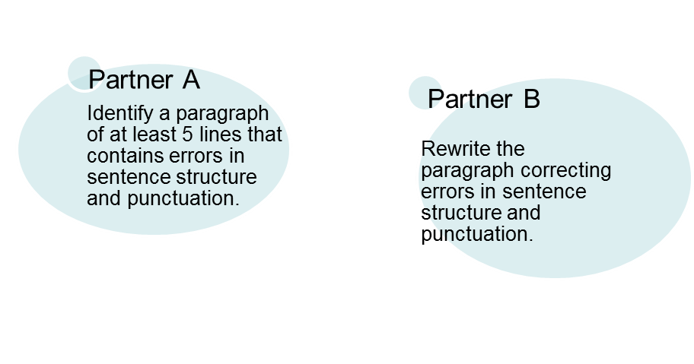
STRUCTURE: How is Hunger Games written

Slide 30
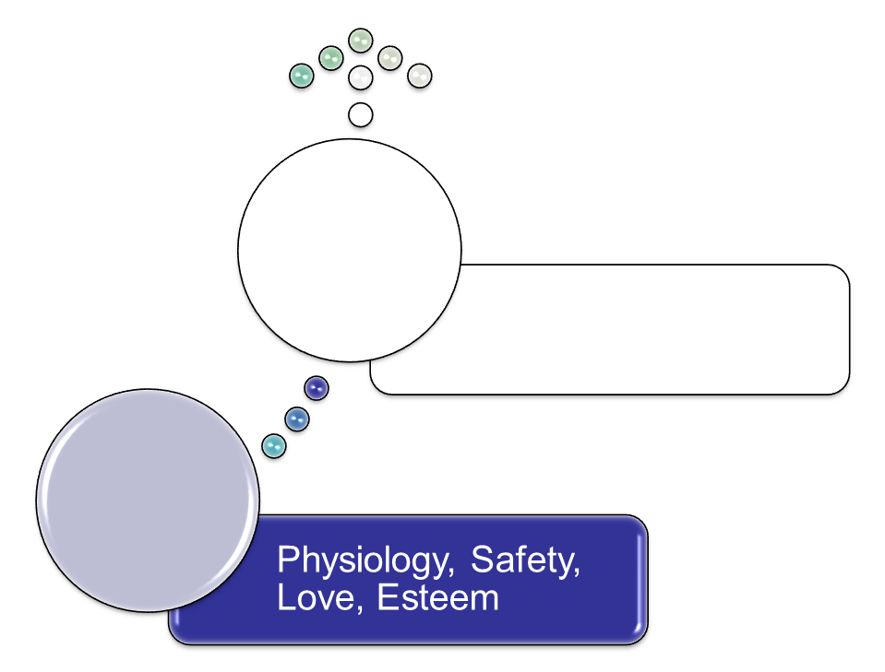
ABRAHAM MASLOW’S
HIERARCHY OF NEEDS
Only 1 in 100 reaches self-actualization
Growth
Basic

Slide 31
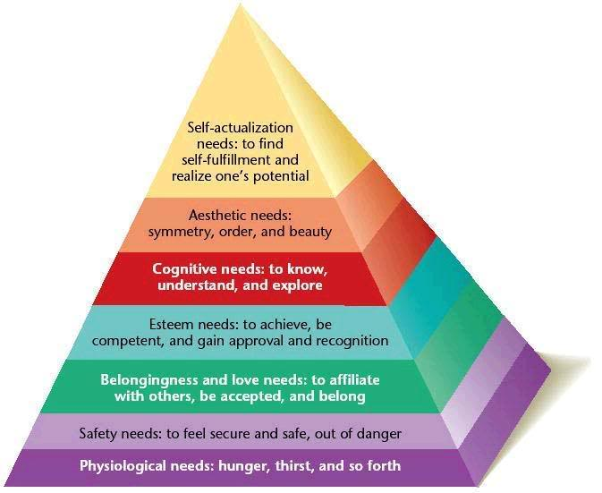
NEEDS PYRAMID
Not original to Maslow

Slide 32

APPLICATION FOR THE Hunger Games
Consider the Katniss and Peter. Provide examples of how each character functions at least 3 levels. In what level do you think each character functions the most? Explain your reasoning. How does your analysis confound Maslow’s theory?

Slide 33
POV

Slide 34
VALUES AND ATTITUDES
What do the characters value?
What does the author value?
How does this support your reader positioning with your own values?

Slide 35
SYMBOLISM
There is a great deal of symbolism which supports the theme and characterisation. List these and give examples.
13 Districts
Mockingjay pin
Dandelions
Reality TV
Food
Rue’s death
Double suicide

